Slide 1
Vezma - Admin
Adding a new user

Slide 2
The process overview
Admin adds a new user → an email invitation is send
The user receives an Admin email invitation and clicks accepts
The user will create password for their private Vezma account
The user installs the Vezma app on their smartphone
The users starts Vezma app
The users logs in with their email address / password that has used when creating Vezma account
The user starts tracking

Slide 3
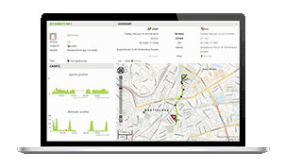
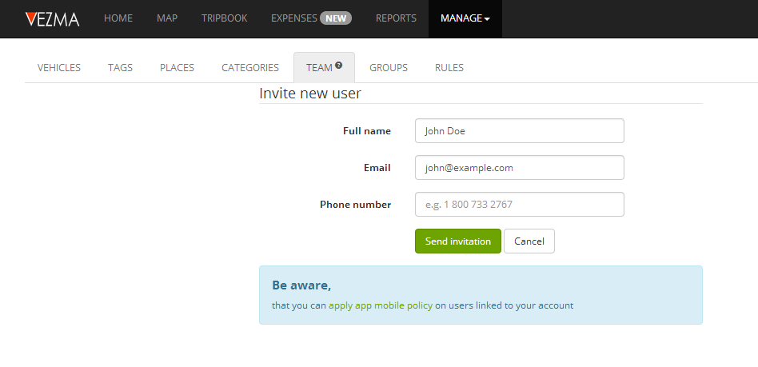
1. Admin invites a new user

Slide 4
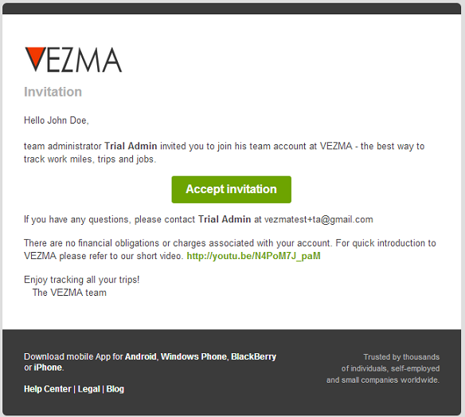
2. User accepts Admin email invitation to join Vezma

Slide 5
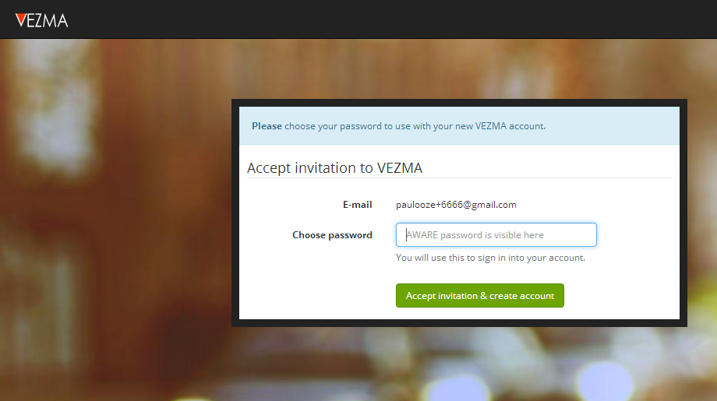
3. User creates Vezma password

Slide 6
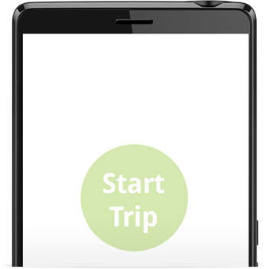
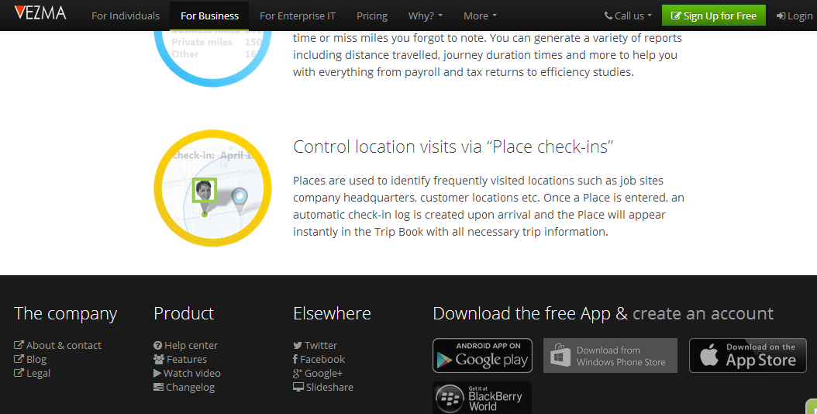
4. Ways to installs Vezma app on the phone
Vezma
Vezma.com
Open Vezma.com page on the phone and in footer
click on download
b) Open Appstore (Google Play, iTunes, Windows phone)
and search Vezma
c) Open Admin invitation email on the phone
and Click on the download button

Slide 7
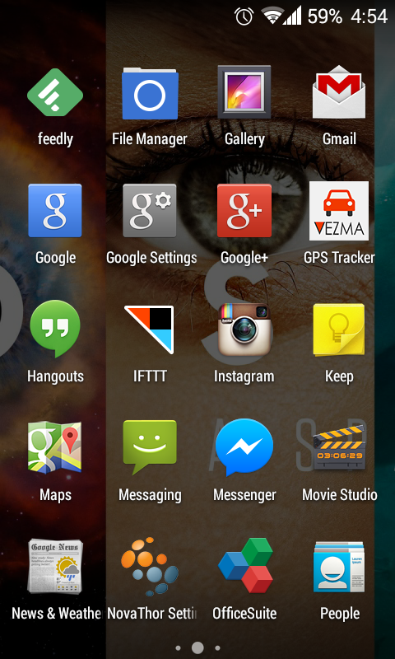
5. User starts the app by clicking on Vezma icon

Slide 8
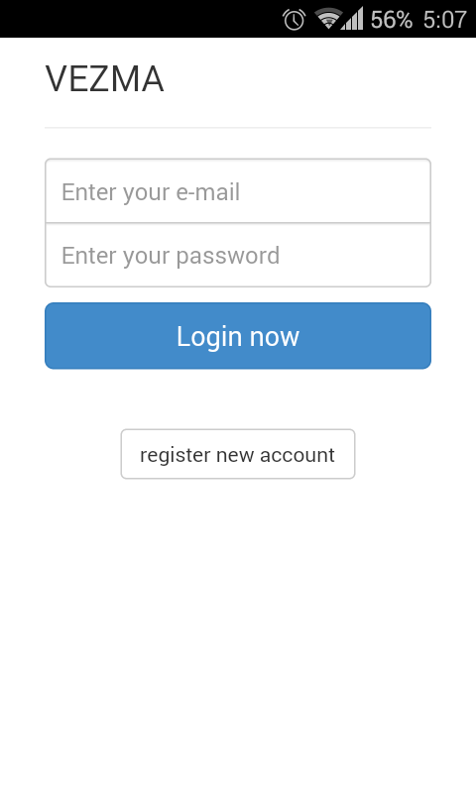
6. User log-ins into on the App providing its email and Vezma password

Slide 9
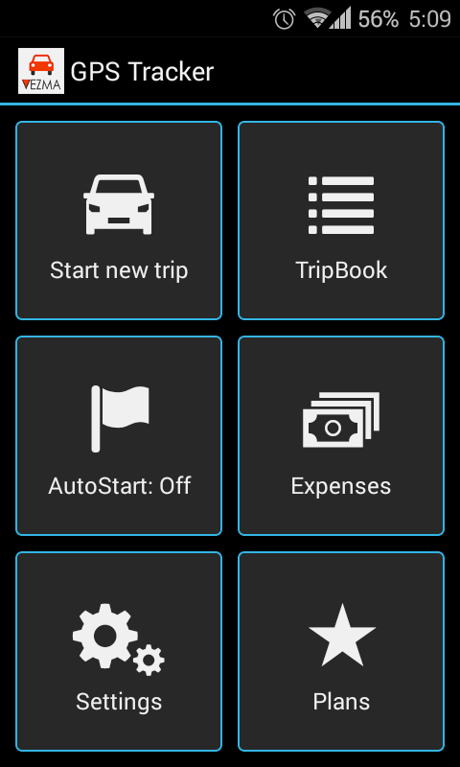
7. The Vezma app is ready to be used

